Slide 1
報告者：林廣學
2013/10/29
10/29進度報告

Slide 2

Last week to do......
Recommand node of Learn API for communication client and server.
To help Yuan develope Interet of connection API in Android.
Input Method........QAQ

Slide 3
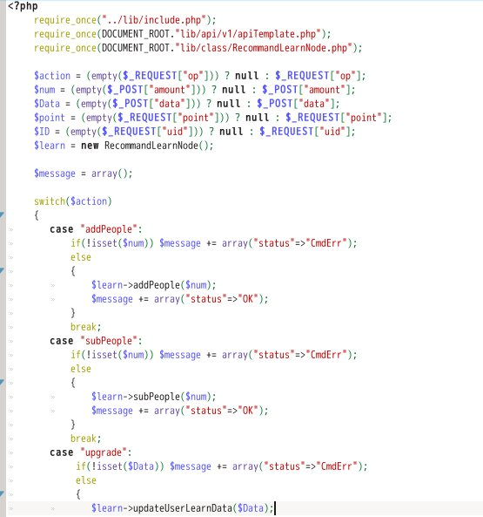
給Client端存取用的推薦學習點API

Slide 4
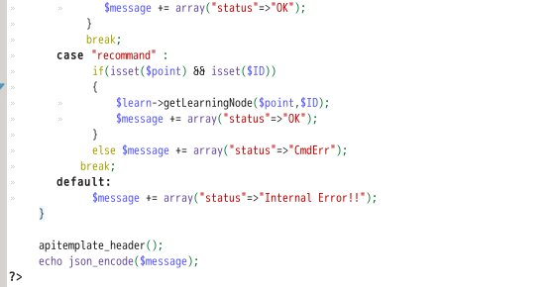
給Client端存取用的推薦學習點API

Slide 5
The End

